Slide 1
Hybrid Model of Convolutional LSTM and CNN to Predict Particulate Matter
Seonggu Lee, Jitae Shin
Sungkyunkwan University (SKKU), Korea
Presented by LEE SEONGGU
Notes:
Good afternoon.
In this time, I’ll introduce my proposed model and my paper which I’m writing
The paper name is Hybrid Model of Convolutional LSTM and CNN to Predict Particulate Matter.
This presentation is silmiar to last presentation but something is change in detail to explain more easily.

Slide 2
Problem Definition
Related Work
Theoretical Background
Proposed method
Experimental Result
Conclusion

Slide 3
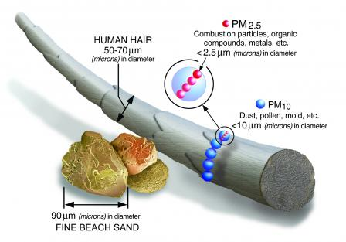
Problem Definition
Particulate Matter (PM)
a very small mixture of solid particles and liquid droplets found in the air.
Size of Particulate Matter
Source : https://www.epa.gov/pm-pollution/particulate-matter-pm-basics
Notes:
Main topic is Particulate Matter (PM).
It is a very small mixture of solid particles and liquid droplets found in the air.
This can get deep into your lungs and some may even get into your bloodstream.
So, It is dangerous for human body.

Slide 4

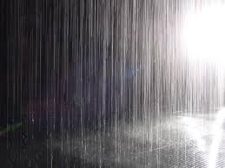
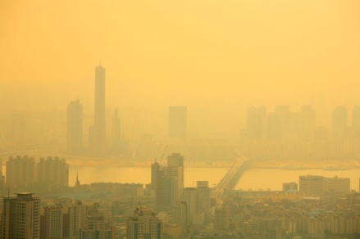
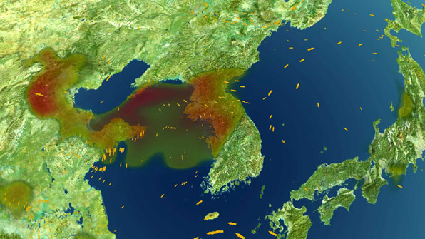
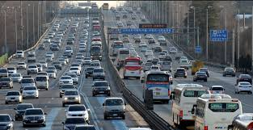
Problem Definition
Challenge in accurate prediction of PM
environmental factors.
humid
rain
PM concentration
inflow from
other area
traffic
Notes:
But there are some problem to estimate PM concentration,
Because PM concentration can be changed depending on various environmental factors
Including humid, rain, traffic and inflow from other area.
So, It is difficult to predict PM concentration exactly.

Slide 5
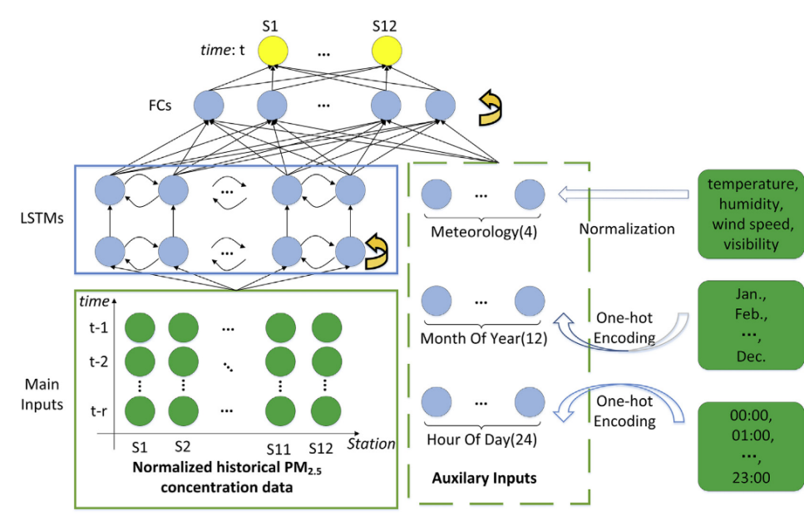
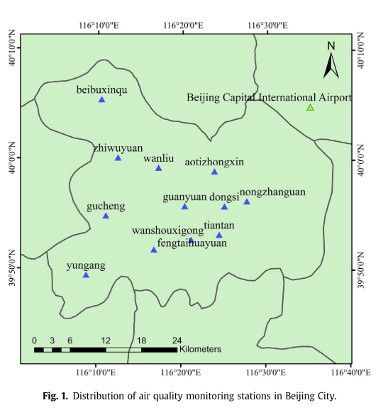
Related work
Long short-term memory (LSTM) neural network
Use LSTM.
Do not consider Spatial information and temporal information together.
Distribution of measuring stations in Beijing City
Network framework of the LSTME model
Source : Li, X., Peng, L., Yao, X., Cui, S., Hu, Y., You, C., & Chi, T. (2017). Long short-term memory neural network for air pollutant concentration predictions: Method development and evaluation. Environmental Pollution, 231, 997–1004.

Slide 6
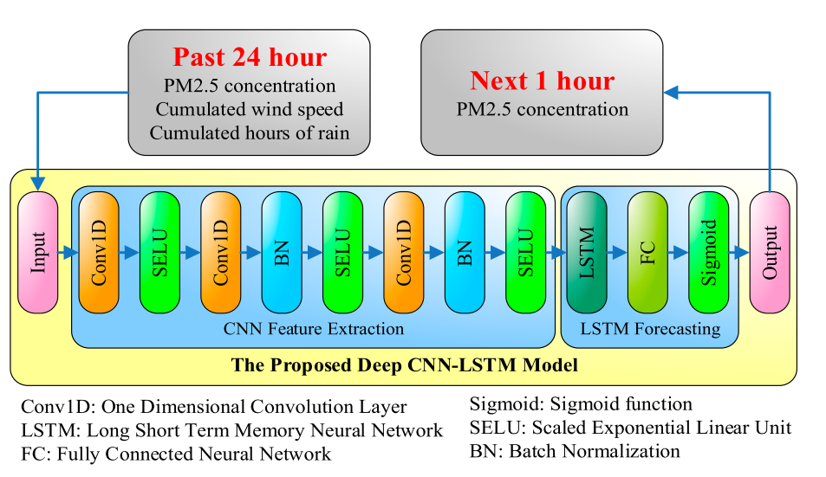
Related work
A Deep CNN-LSTM Model
Use additional 1D CNN to extract important temporal feature.
Exclude a spatial information.
Source : Huang, C. J., & Kuo, P. H. (2018). A deep cnn-lstm model for particulate matter (Pm2.5) forecasting in smart cities. Sensors (Switzerland), 18(7).

Slide 7
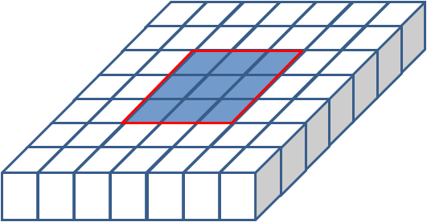
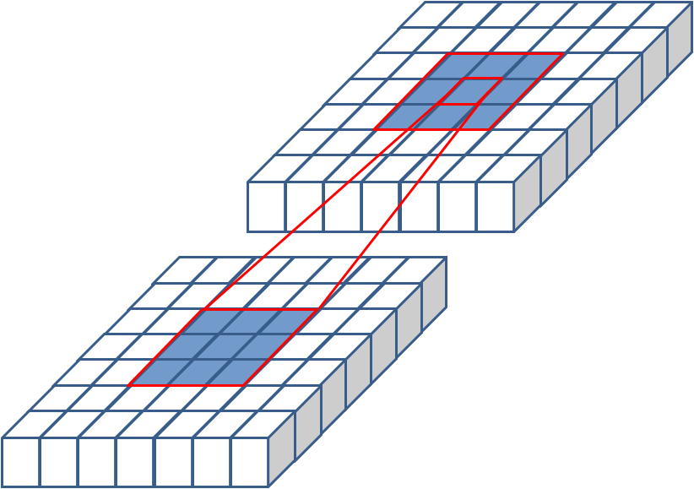
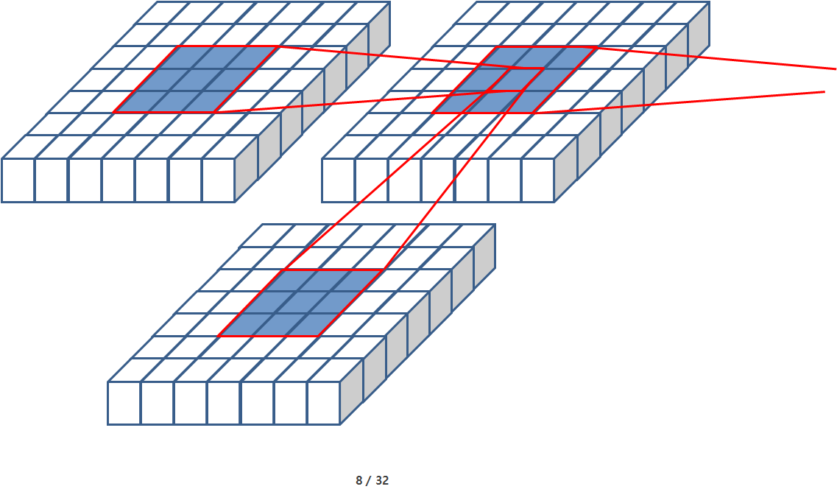
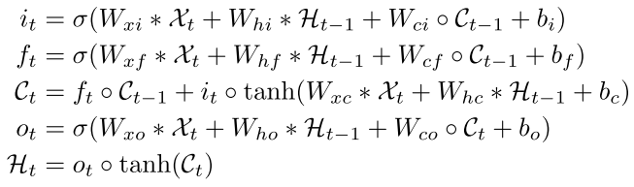
Theoretical Background
Convolutional Long-Short Term Memory (ConvLSTM)
row
time
Ht-1, Ct-1
Ht, Ct
Ht+1, Ct+1
column
CNN kernel
feature
Xt
Xt+1
3D Tensor (row x column x feature)
Inner structure of ConvLSTM
ConvLSTM Equation
Source : Shi, X., Chen, Z., & Wang, H. (n.d.). Convolutional LSTM Network : A Machine Learning Approach for Precipitation Nowcasting arXiv : 1506 . 04214v2 [ cs . CV ] 19 Sep 2015, 1–12.

Slide 8
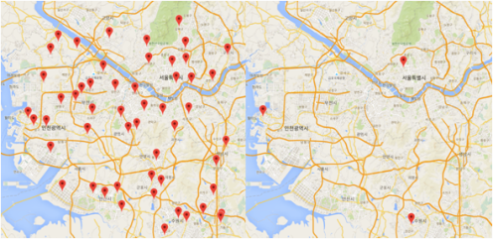
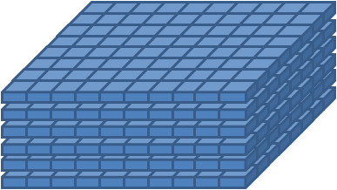
Proposed method
Overall flow diagram
Dataset
<PM Data>
<Meteorological data>
data pre-processing
Conjugated 4D Tensor (past 24 hour)
…
Split
(row x column x feature) x time
Training Data
Testing Data
Feed forward
Hybrid (Convolutional LSTM + 3D CNN) Model
next 4 hour PM predicted value of all stations

Slide 9
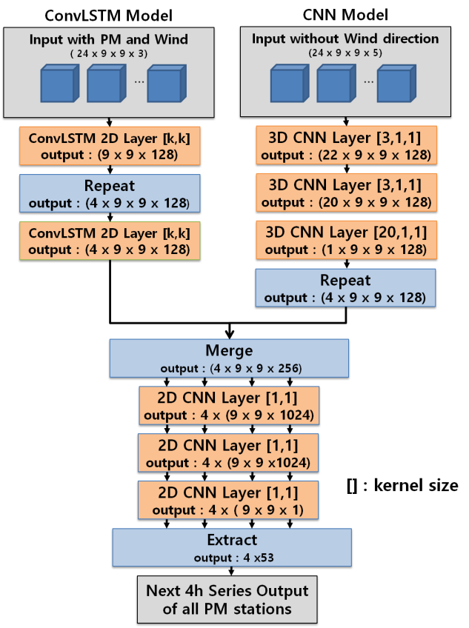
Proposed method
Hybrid model
Green box : use spatiotemporal information and keep this.
Encoder
Decoder
Blue box : extract temporal information in parallel.
Red box : use encoder and decoder respectively, to predict multiple(4h) future

Slide 10
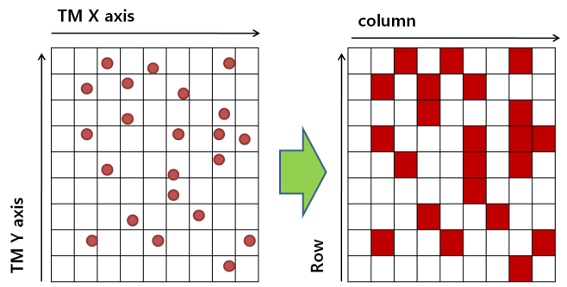
Proposed method
Pre-processing
1. Grid Mapping
for ith station,
Grid mapping of station distribution

Slide 11
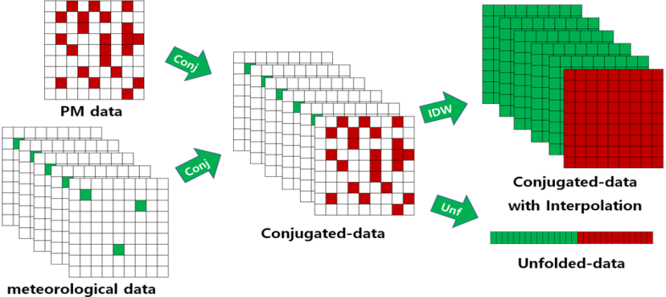
Proposed method
Pre-processing
2. Conjugation
3. Interpolation with Inverted Distance Weight (IDW)
(4. Unfolding)
IDW Equation
Conjugation, interpolation and unfolding
Notes:
2. Conjugation The meteorological data and the PM data were combined and it represents a three-dimensional tensor in every time slice.
3. Interpolation with Inverted Distance Weight (IDW)
All missing values were interpolated with IDW.
4. Unfolding To compare other models which don’t consider spatial informations, we also prepare unfolded-data.
,

Slide 12
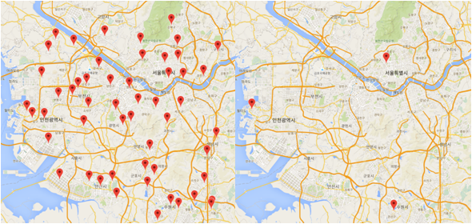
Experimental Result
Input Parameter
Region
Gyeonggi, Incheon, Seoul
Measurement Period
2014.1.1 1:00 – 2016.12.31 24:00
Feature | Unit | Source
1h PM10 concentration | ug/m³ | 53 of PM10 stations
1h Temperature | ℃ | 3 of meteorological stations
1h Humid | % | 3 of meteorological stations
1h Vapor Pressure | hPa | 3 of meteorological stations
1hWind speed | m/s | 3 of meteorological stations
1h Wind direction | ° | 3 of meteorological stations
PM station(left) and meteorological station(right)

Slide 13
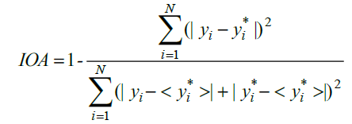


Experimental Result
Comparison of rmse of the different model
Model | Next 1-hour | Next 2-hour | Next 3-hour | Next 4-hour | Average
Hybrid [1,1] | 10.49 | 14.36 | 17.04 | 19.13 | 15.25
Hybrid [3,3] | 9.76 | 13.36 | 16.38 | 18.86 | 14.59
Hybrid [5,5] | 10.44 | 13.72 | 16.59 | 18.99 | 14.93
ConvLSTM [3,3] | 9.85 | 13.61 | 16.69 | 19.19 | 14.84
CNN-LSTM | 13.91 | 15.41 | 17.33 | 19.26 | 16.48
LSTM | 13.90 | 16.00 | 17.99 | 19.67 | 16.89
Comparison of mae of the different model
Model | Next 1-hour | Next 2-hour | Next 3-hour | Next 4-hour | Average
Hybrid [1,1] | 7.35 | 9.77 | 11.47 | 12.80 | 10.35
Hybrid [3,3] | 6.89 | 9.11 | 11.03 | 12.62 | 9.91
Hybrid [5,5] | 7.41 | 9.46 | 11.30 | 12.86 | 10.26
ConvLSTM [3,3] | 6.95 | 9.27 | 11.23 | 12.84 | 10.07
CNN-LSTM | 9.80 | 10.63 | 11.75 | 12.89 | 11.27
LSTM | 9.89 | 11.24 | 12.48 | 13.49 | 11.78
Comparison of ioa of the different model
Model | Next 1-hour | Next 2-hour | Next 3-hour | Next 4-hour | Average
Hybrid [1,1] | 0.9654 | 0.9309 | 0.8959 | 0.8624 | 0.9136
Hybrid [3,3] | 0.9703 | 0.9415 | 0.9089 | 0.8768 | 0.9244
Hybrid [5,5] | 0.9647 | 0.9361 | 0.9038 | 0.8717 | 0.9191
ConvLSTM [3,3] | 0.9695 | 0.9378 | 0.9028 | 0.8686 | 0.9197
CNN-LSTM | 0.9385 | 0.9240 | 0.9026 | 0.8776 | 0.9107
LSTM | 0.9353 | 0.9109 | 0.8840 | 0.8579 | 0.8971
Notes:
And This is final result.
I used the 3 indicator including the root mean square error (RMSE), the mean absolute error (MAE), and the index of agreement (IOA).
The IOA denotes how closely the predicted value matches the actual value. If the predicted value is close to the true value, the IOA value is close to 1.
The number in square bracket means Convolutional LSTM kernel.-
In all case, Hybrid model with 3 by 3 kernel size showed best result among the model,
Except prediction of Next 4-hour using IoA indicator.

Slide 14

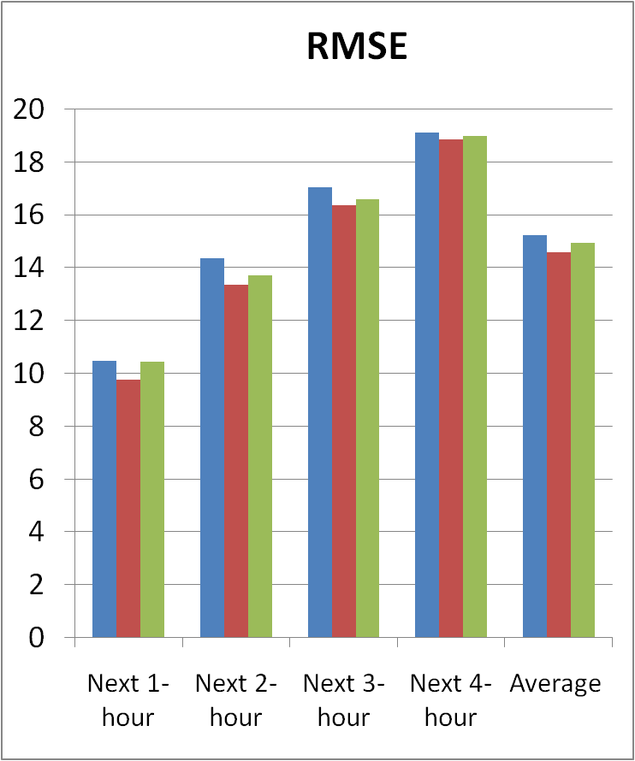
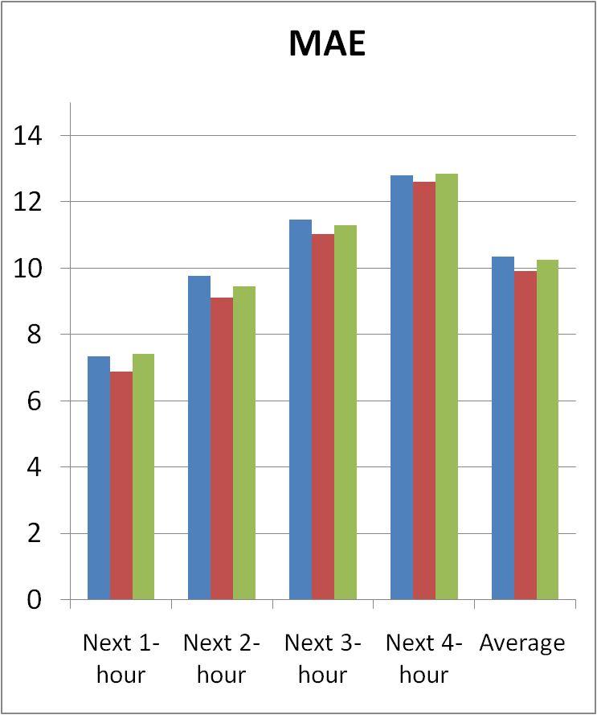
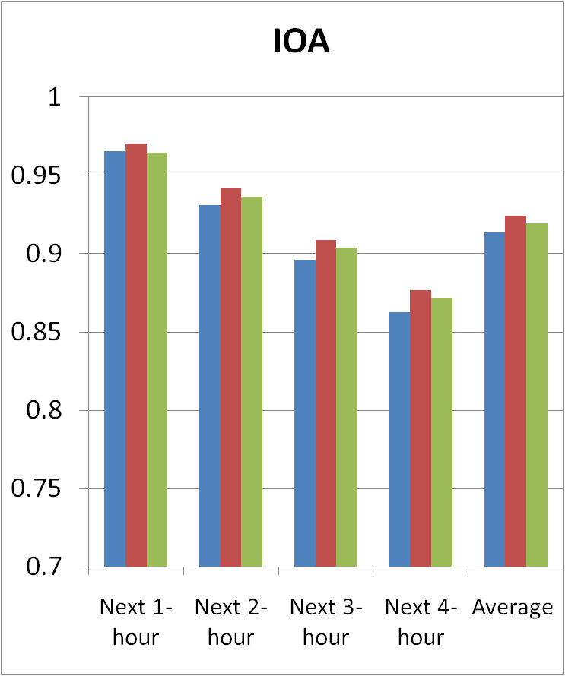
Experimental Result
Hybrid model with different kernel size
Notes:
And I show you the result graph the to compare there model easily.
This slide showed the same model but have different kernel size.
if the kernel size is larger, predicted value can be affected by the more distant measuring stations in every prediction time
the Hybrid model with [3,3] kernel size shows the best performance in all indicators and the Hybrid model with [5,5] kernel size
shows the better performance than the Hybrid model with [1,1] kernel size.
If the kernel size is [1,1], the ConvLSTM layers in the Hybrid model cannot extract additional spatial features from the near measuring stations.
Therefore, the result shows that extracting additional spatial features makes the performance better
.

Slide 15
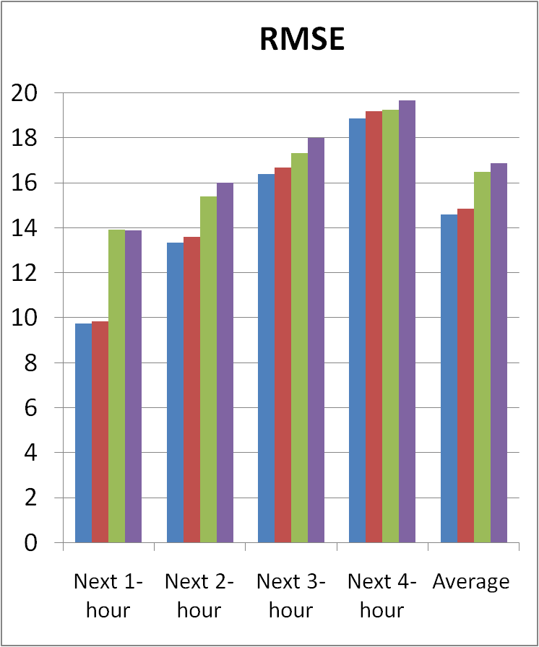
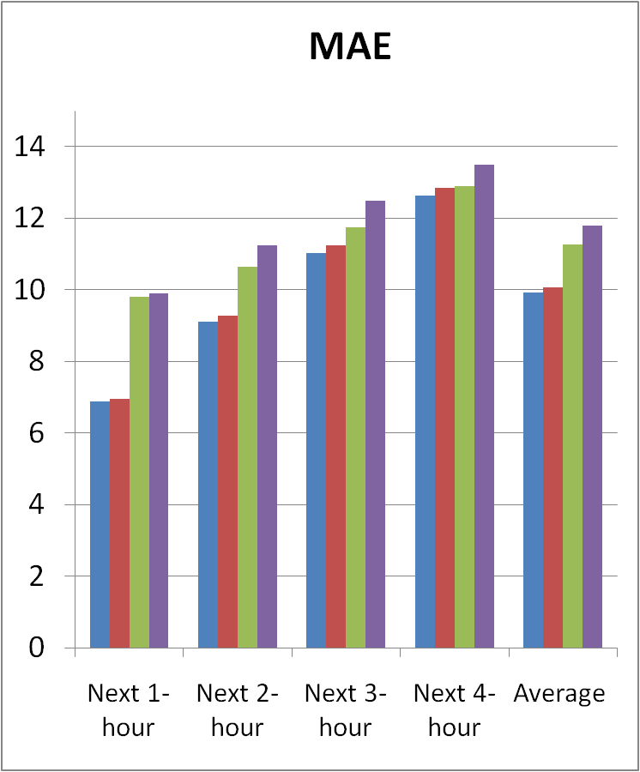
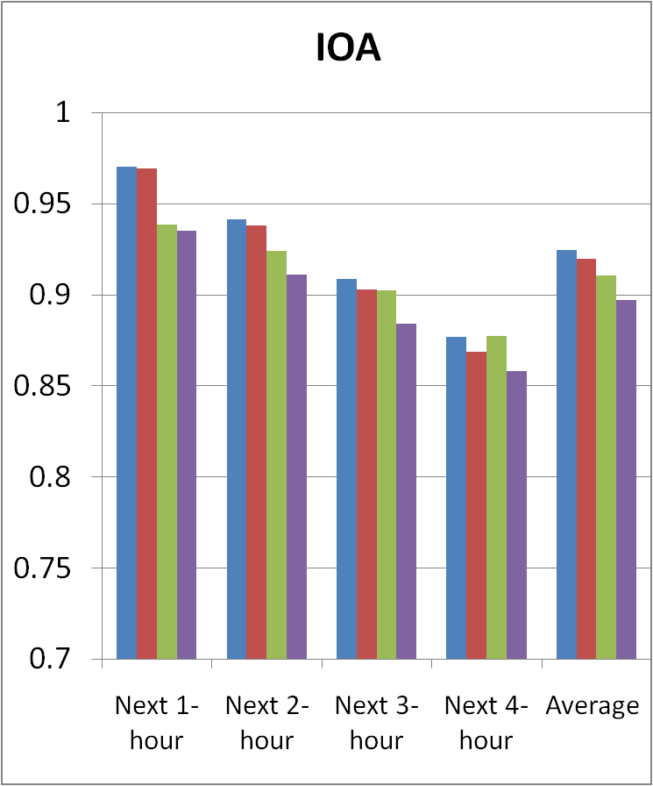
Experimental Result
Comparison with the different models
 | Hybrid [3,3] | ConvLSTM [3,3] | 1D CNN-LSTM | LSTM
Keep spatiotemporal Data | O | O | X | X
Extract temporal Data in Parallel | O | X | O | X
Notes:
Compared with all models, Hybrid models and ConvLSTM model which keep two-dimensional spatial information
show better results than CNN-LSTM and LSTM which do not keep the spatial information through unfold process of input data.
This result represents that in order to estimate the PM concentration of many measuring stations from many measuring stations,
it is reasonable to keep the spatial information.
Also, the Hybrid model shows better performance than ConvLSTM model which have the same kernel size on ConvLSTM layers.
This shows that the combination of 3D CNN layers that extract temporal features in parallel can help to improve the performance.
(The best kernel size for effectively extracting spatial information from the given dataset is not [5,5] but [3, 3]. This means that the model with large kernel size can cause performance degradation because more distant measuring stations used to every time slices input is not relevant to predict target measuring stations.)
Keep spatiotemporal Data을 적용하면
근거리 시간 내에 성능 향상이 뚜렷하게 이뤄짐
Extract temporal Data in Parallel을 적용하면
장시간 예측시에 성능향상이 뚜렷하게 이뤄짐.

Slide 16
Conclusion
Proposed hybrid model to predict PM
Hybrid model using ConvLSTM and 3D CNN.
Raw data are pre-processed with grid mapping, conjugation and interpolation.
Better prediction performance
Keep and process spatiotemporal information.
Choice appropriate kernel size [3,3] in ConvLSTM layer.
Extract temporal features in parallel.
Notes:
Raw data are pre-processed with grid mapping, conjugation and interpolation to feed the hybrid model correctly.

Slide 17
Presented by LEE SEONGGU
dltjdrn1123@skku.edu
Notes:
질문
pre-processing 작업
다른 모델들과 비교를 할 때, grid mapping이 들어갔는지?
모델 비교를 하려면 같은 preprocessing이 들어가야 하는데,
-
- 왜, 영향 요인 중, traffic과 rain을 쓰지 않았는가?

